Slide 1

Drivers of rent: Presentation to the HTWG
August 2022

Slide 2
Why are we interested in this?
Rent is more closely related to the (wellbeing) outcomes
renters typically pay a larger proportion of their incomes on housing costs compared to homeowners
Rent price could be a better signal of the supply-demand imbalance in the housing market
it reflects the “true” cost of housing consumption
Research on drivers of rent are quite limited, both internationally and in NZ

Slide 3
Approach
We have identified a list of possible factors that may drive rent from the literature:
Variables | Channel | Expected sign | Measure
Lagged rent inflation | Persistence | +
Income/wage | Renters’ ability to pay | + | QES average weekly earnings/LEED quarterly earnings (regional)
Relative demand and supply |  | + | People per dwelling/Vacancy rate/Vacant time
Home loan credit conditions | Homeownership rate | - | Floating mortgage rate
General inflation | Landlords’ expense | + | CPI excluding rent
Labour market conditions, e.g unemployment rate | Job security Economic outlook | + | Unemployment rate
Interaction of two or more of the above

Slide 4
Approach
A simple, reduced-form equation with lags in order to reduce endogeneity issue
Main dependent variable: Rent inflation (Annual change of RPI flow)
Estimation period: Q1-2006 to Q1-2022
Notes:
RPI for new tenancies
Potential reverse causality between wage and rent (wage-price spiral) or people per dwelling and rent (high rent reduces people per dwelling as people moving out)
We are choosing annual change as the monthly or even quarterly change in CPI is noisy.

Slide 5
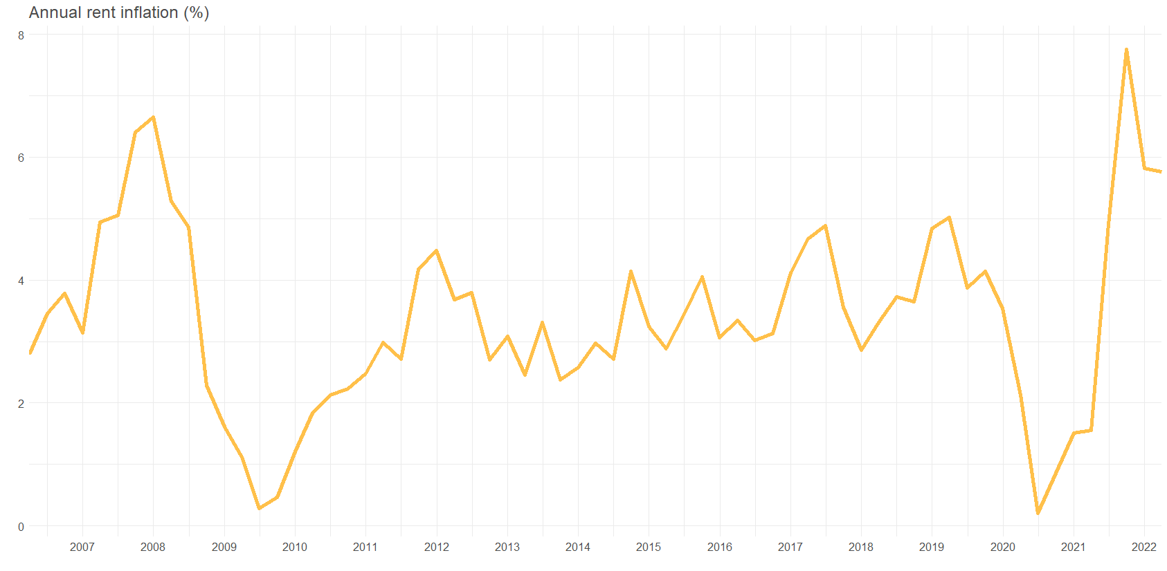

Slide 6
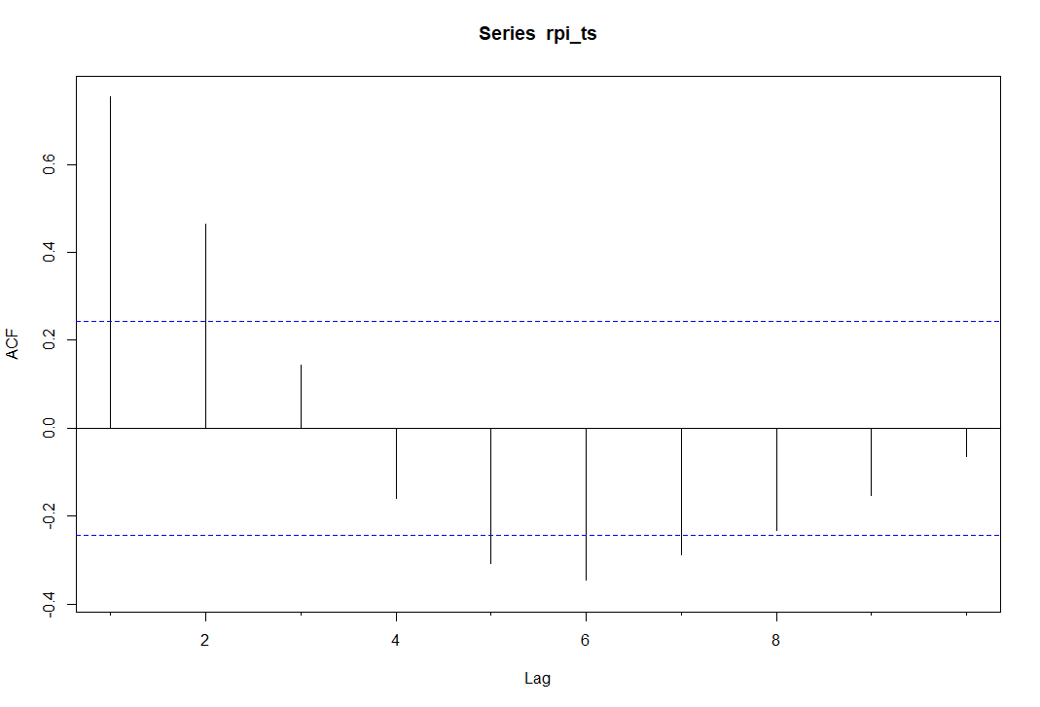
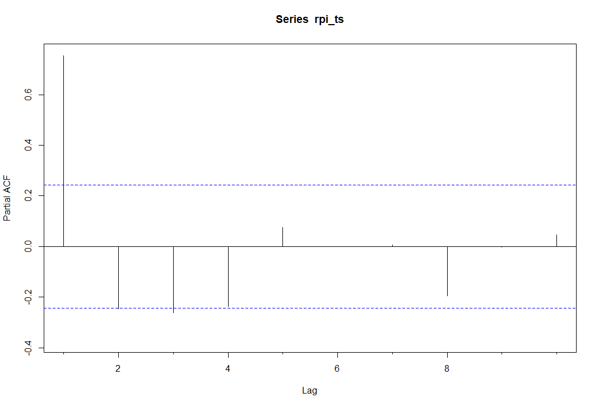
At least the first lag of rent inflation needed to be included as an explanatory variable

Slide 7
Most key variables have expected signs
 | Annual rent inflation | Annual rent inflation | Annual rent inflation | Annual rent inflation | Annual rent inflation
Rent inflation (lagged) | 0.733 *** (0.088) | 0.716 *** (0.089) | 0.531 *** (0.109) | 0.532 *** (0.111) | 0.557 *** (0.123)
Wage growth (deviation from sample mean 3.66, lagged) | 0.165 * (0.088) | 0.188 ** (0.090) | 0.224 ** (0.087) | 0.225 ** (0.099) | 0.250 ** (0.108)
People per dwelling (deviation from sample mean 2.57, lagged) |  | 3.312 (3.171) | 4.498 (3.044) | 4.489 (3.100) | 5.981 (3.843)
Change in floating mortgage rate (lagged) |  |  | 0.033 *** (0.012) | 0.033 ** (0.012) | 0.033 ** (0.013)
Inflation excluding rents |  |  |  | -0.002 (0.090) | 0.016 (0.097)
Unemployment rate (lagged) |  |  |  |  | 0.131 (0.191)
Observations | 64 | 64 | 64 | 64 | 62
R² / R² adjusted Quarter fixed effects | 0.622 / 0.589 Yes | 0.629 / 0.590 Yes | 0.671 / 0.630 Yes | 0.671 / 0.623 Yes | 0.674 / 0.617 Yes
* p<0.1 ** p<0.05 *** p<0.01
Notes:
Interpretation in the next slide
Demeaning some of the variables makes interpretation a little bit easier (especially once we start including interaction variables)
Rate of change in mortgage rates is more significant than the level
Three issues (inflation/unemployment rate/people per dwelling)

Slide 8
Interpreting key coefficients
Variables | Change | Effect
Wage | 1 percentage points increase in wage growth | 0.25 percentage points increase in rent inflation
Relative demand and supply | 200,000 additional people or 74,000 less dwellings from Q4-2021 level | 0.5 percentage points increase in rent inflation
Home loan credit conditions | 10 percent increase in floating mortgage rate from same time last year | 0.3 percentage points increase in rent inflation
General inflation | 1 percent increase in inflation excluding rents | 0.01 percent increase in rent inflation

Slide 9
The relationship between rent inflation and general inflation is not constant over time
 | Annual rent inflation
 | Estimates
Inflation excluding rents | 0.046 (0.108)
Covid period | -1.703 ** (0.788)
GFC period | 4.388 *** (1.092)
Covid x inflation | 0.528 ** (0.221)
GFC x inflation | -0.931 *** (0.301)
Observations | 62
R² / R² adjusted | 0.770 / 0.707
* p<0.1 ** p<0.05 *** p<0.01
Notes:
Overall, positive relationship
Negative during GFC but positive during Covid pandemic period

Slide 10
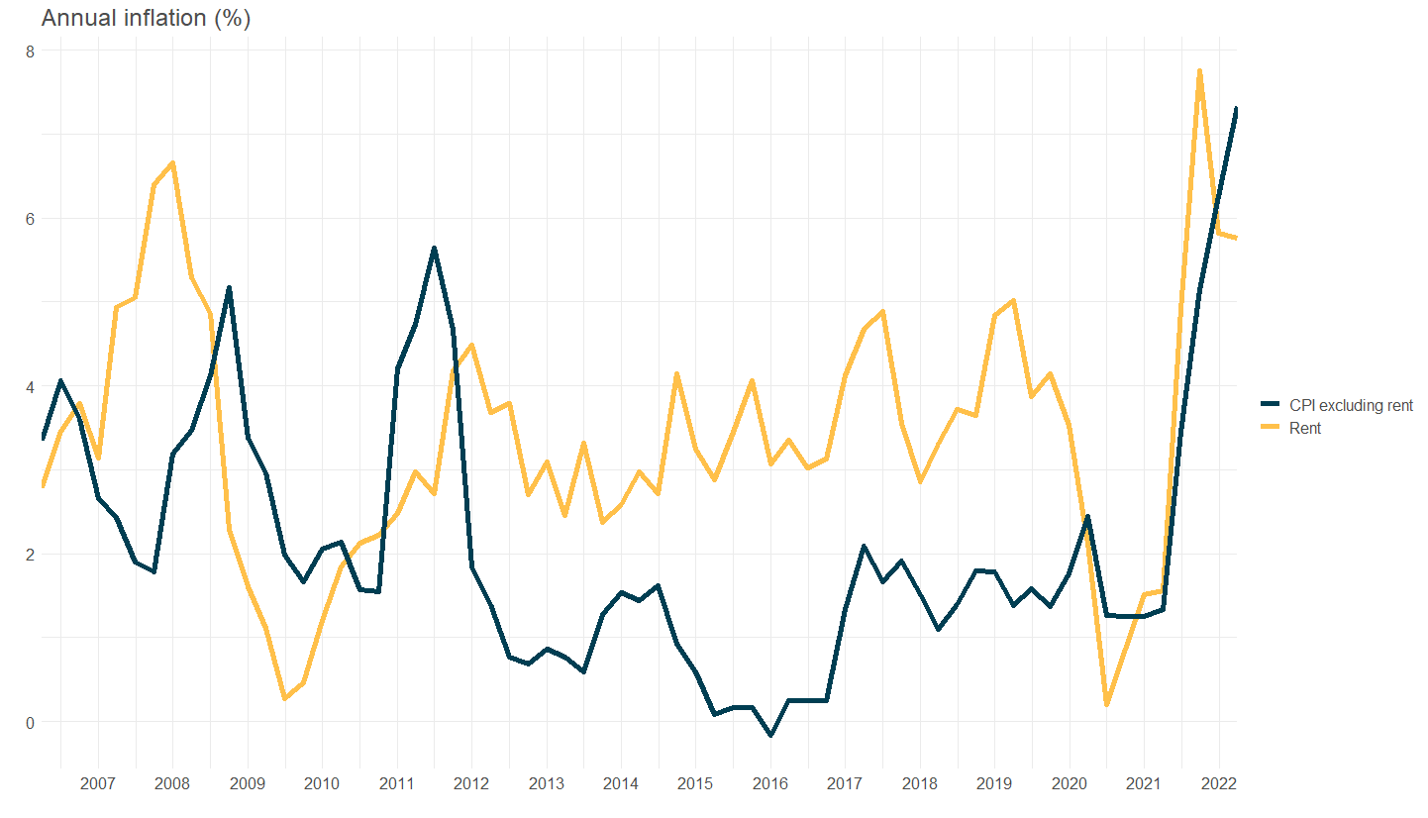

Slide 11
Negative correlation between rent inflation and future value of unemployment rate
 | Annual rent inflation
 | Estimates
Unemployment rate (lagged) | 0.650 * (0.338)
Unemployment rate (contemporaneous) | 0.377 (0.444)
Unemployment rate (lead) | -1.207 *** (0.345)
Observations | 61
R² / R² adjusted | 0.733 / 0.673
* p<0.1 ** p<0.05 *** p<0.01
RPI flow (t0)
RPI stock (t1)
Unemployment rate (t1)
Notes:
Technicality: Dependent variable is RPI flow (new tenancies). This leads RPI stock. The negative correlation between rent and unemployment is at stock level (e.g in the US). Therefore, RPI flow would correlate with future values of unemployment rate
Intuition: Rents are set with future labour market conditions is mind
This is useful to understand the relationship but not for forecasting purposes

Slide 12
The bigger the supply and demand gap, the stronger the correlation between wage and rent
 | Measure of relative supply and demand
 | People per dwellings | Vacancy rate (new bonds/active bonds) | Median vacant time
Wage growth (deviation from sample mean 3.66, lagged) | 0.20 ** (0.10) | 0.85 ** (0.36) | 0.18 * (0.09)
People per dwelling (deviation from sample mean 2.57, lagged) | 5.80 * (3.06)
Wage growth x People per dwelling | 4.78 ** (2.20)
Vacancy rate (lagged) |  | -0.05 (0.17)
Wage growth x Vacancy rate |  | -0.15 * (0.08)
Change in vacant time (lagged) |  |  | -0.12 * (0.06)
Wage growth x Change in vacant time |  |  | -0.06 *** (0.02)
Observations | 64 | 64 | 64
R² / R² adjusted | 0.697 / 0.647 | 0.686 / 0.634 | 0.719 / 0.673
* p<0.1 ** p<0.05 *** p<0.01
Notes:
Higher people per dwelling (more demand relative to supply) => stronger relationship between wage and rents
Higher vacancy rate (more supply relative to demand) => weaker relationship between wage and rents
Higher vacant time (properties take longer to fill => more supply relative to demand) => weaker relationship between wage and rents

Slide 13
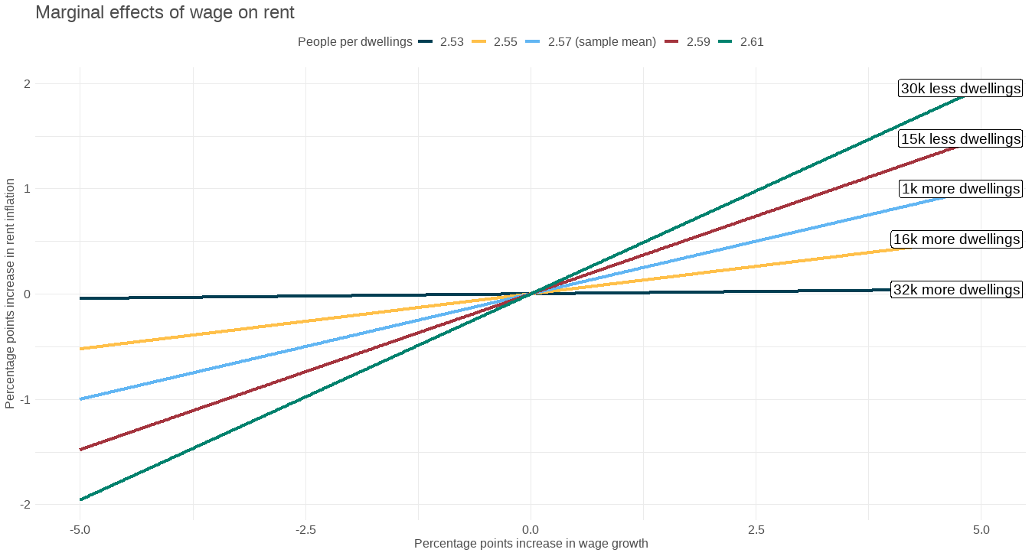
The bigger the supply and demand gap, the stronger the correlation between wage and rent
Notes:
Change from Q4 2021, assuming population stays the same
If people per dwelling is 2.53, the marginal impact of wage on rent diminishes to 0

Slide 14
Key takeaways
Rent inflation is persistent
Wage, relative supply and demand, and credit conditions are the main drivers of rent
Overall, the explanatory variables can explain around 60-70% of the variation
Rent and wage tend to track each other over time. However, the bigger the supply and demand gap, the stronger the impact of wage on rent

Slide 15
Next steps
Panel regression with regional fixed effects
Look at how the key coefficients vary at regional level

Slide 16
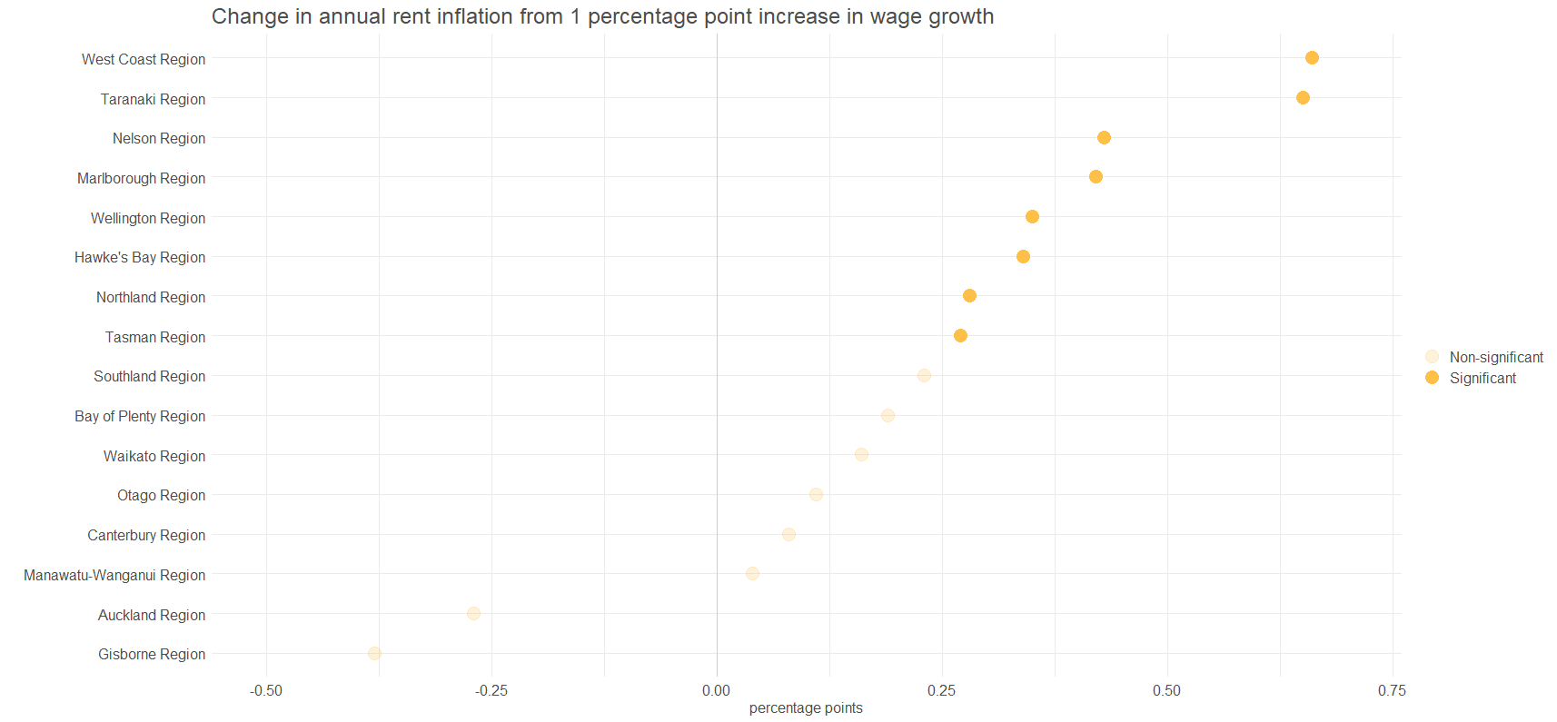
Notes:
5% significance level

Slide 17
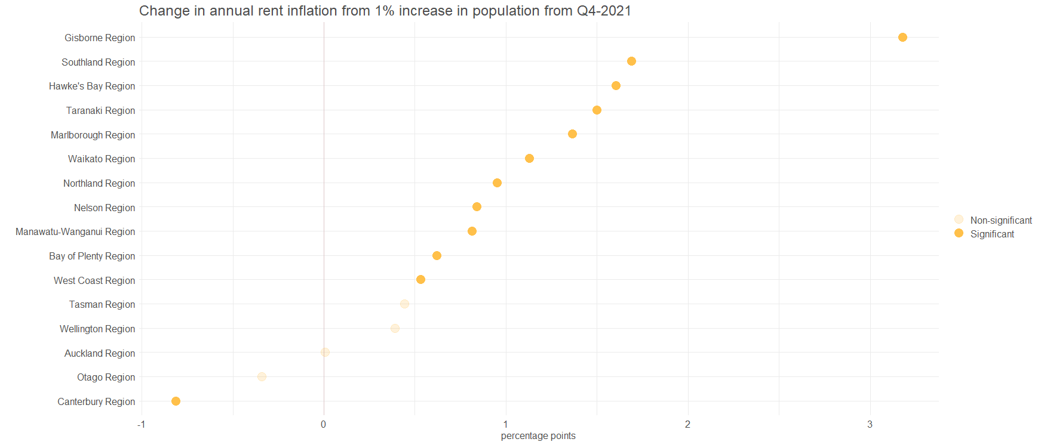
Notes:
5% significance level

